Slide 1
DS Intermediate Capstone
Justin Chaphiv

Slide 2
Project Goal
Goal of the project is to create a classification model using natural language processing that could accurately categorize a movie’s genre based on a plot description.

Slide 3
Data Set
Wikipedia Movie Plots from Kaggle.com
https://www.kaggle.com/jrobischon/wikipedia-movie-plots/version/1
8 columns/Features
Release year
Title
Origin/ethnicity of movie
Director
list of main actors/actresses
Genre
Wiki page link
Plot
Movies from 1903-2017

Slide 4
Data Set Cleaning
Data set has 34,886 records
6,083 records were dropped due to have no genre
Over 2000 different types of genres in original data set
Created a copy of dataframe using only the top 15 genres
Reducing the dataset to 18,921 records

Slide 5
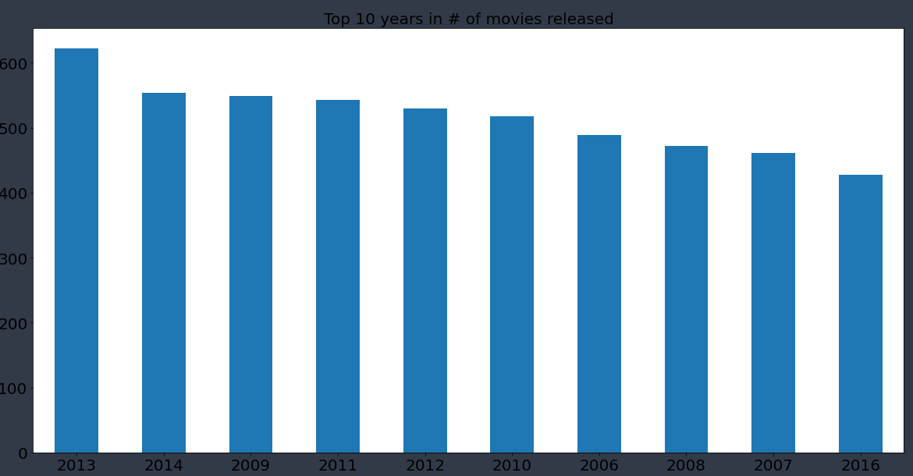
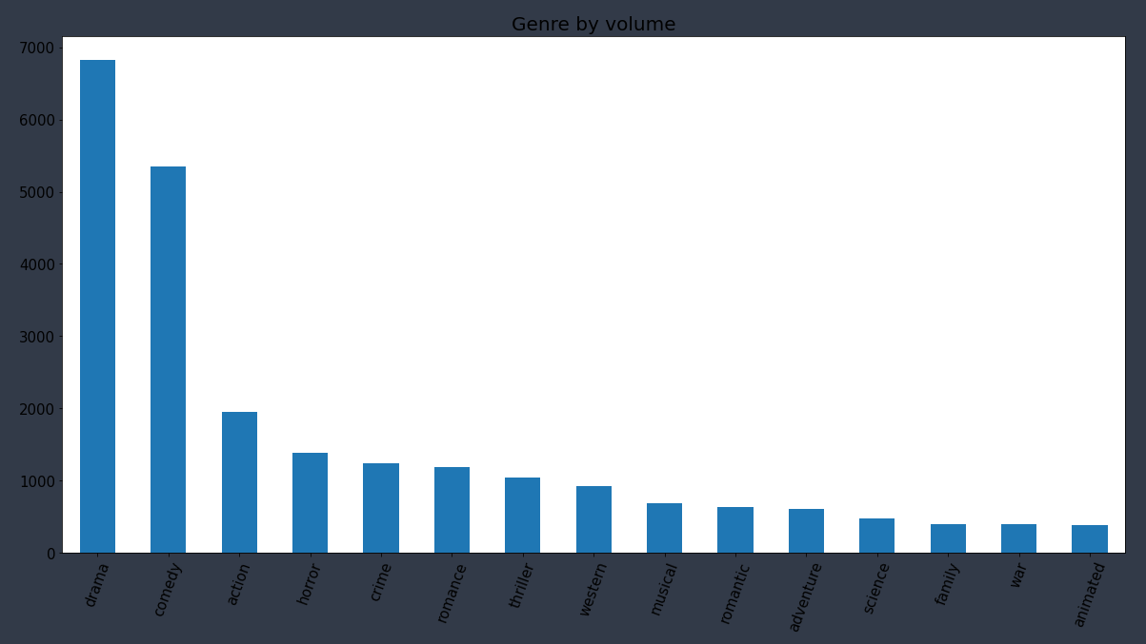
EDA Visualization
Most movies release in 2013
Most popular genre of movies created by far are Comedy and Drama

Slide 6
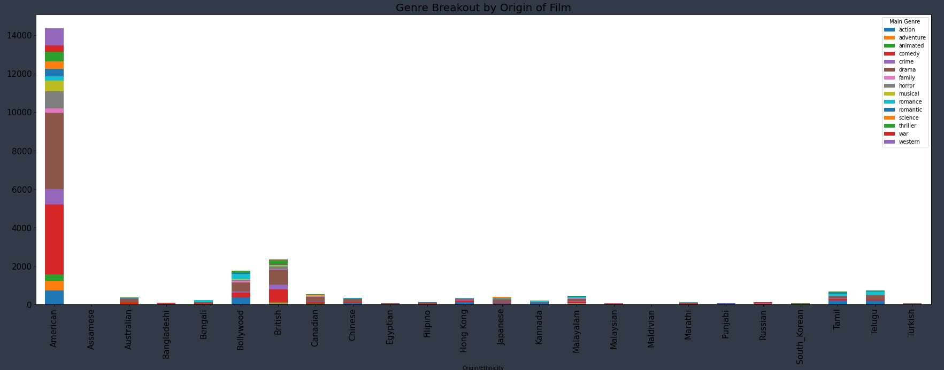
EDA Viz cont.

Slide 7
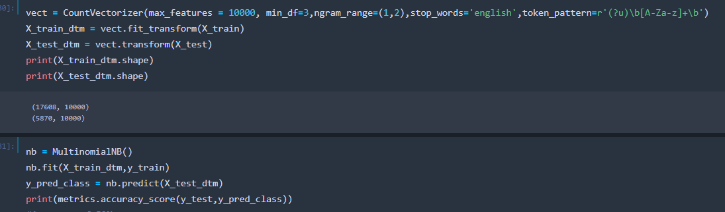
Model methodology
Created Document-Term Matrix (DTM) using count vectorizer and ran through a Naive Bayes classifier model
Tried using grid-search to optimize the parameters for the model but it was taking hours to run.
Parameters chosen were ones I believed worked best and gave me the best results off the trails I ran

Slide 8




Model results
Model resulted in accuracies of 47-52% based off the test data
Ran the model on some of my favorite movies not listed in the original data set and resulting in a corrected prediction rate of 40%

Slide 9
Conclusion
Inherent flaws of the plot descriptions, genres very subjective
Model is somewhat of a coin flip
Would’ve liked more time to run the grid search
Selection of genre could maybe be more narrowed down

Slide 10
Questions?

